Slide 1

Africa’s Development dynamics 2024
Skills, Jobs and Productivity
18 September 2024
Casa África, Las Palmas de Gran Canarias
Federico Bonaglia
Deputy Director
OECD Development Centre

Slide 2

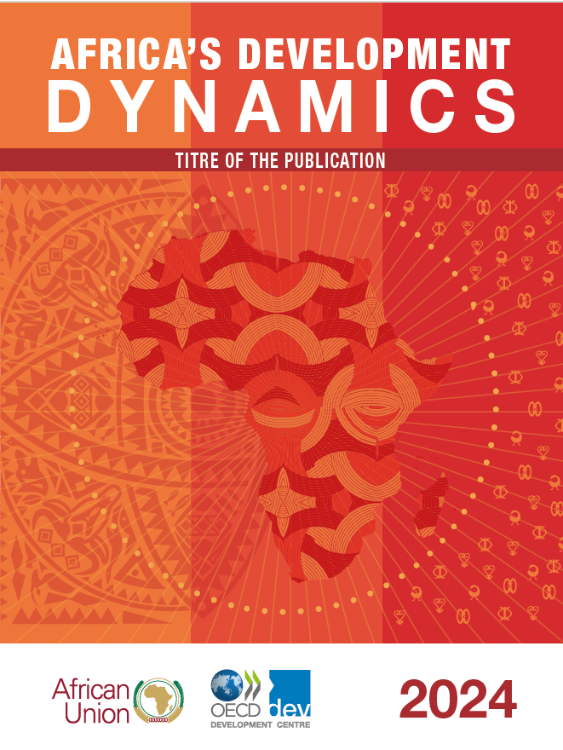















A collaborative & inclusive approach to policy-making:
Africa’s Development Dynamics report
+
OECD expertise
+
African academics
|CFE
|SKC
|DAF
|DCD
|ELS
|EDU
|GOV
|SGE
|STI
|TAD
Notes:
The AfDD report results from a partnership between the African Union Commission and the OECD Development Centre. It benefits from support by the European Union, the German Ministry of Development Cooperation (BMZ) and its technical agency GIZ, the Ministry of Foreign Affairs of Portugal and the Camões Institute, the Ministry of Foreign Affairs of Italy, the African Capacity Building Foundation (ACBF), and the African Union Development Agency (AUDA-NEPAD).
The report draws on the knowledge and expertise of Professors from leading African universities who drafted the 5 regional chapters with a focus on investments in strategic sectors:
Investing in natural ecosystems in Central Africa
renewable energy in Southern and East Africa
sustainable finance in North Africa
agri-food supply chains in West Africa.

Slide 3
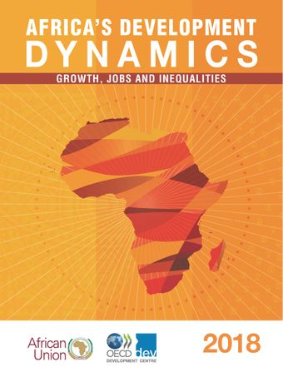
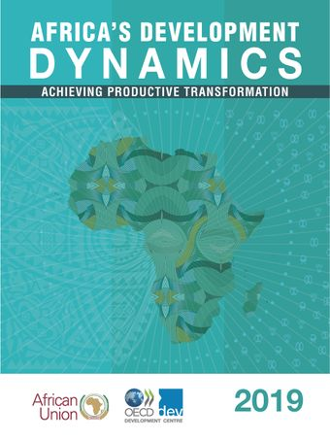
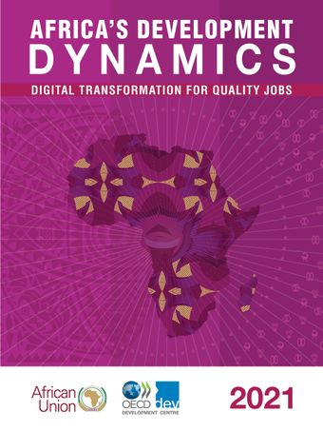
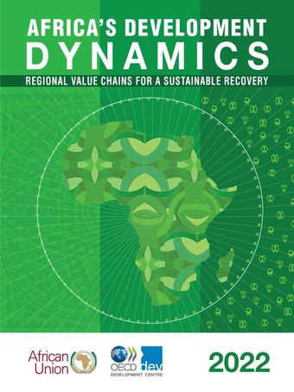
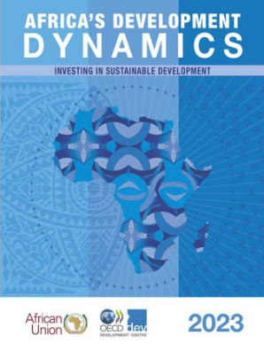
The AfDD2024 is part of an ongoing series on policies for generating sustainable growth in Africa
2018: Growth, Jobs and Inequality
2019: Achieving Productive Transformation
2021: Digital Transformation for Quality Jobs
2022: Regional Value Chains for a Sustainable Recovery
2023: Investing in Sustainable Development
2024: Skills, Jobs and Productivity

Slide 4
Key messages of the report
Skills development can increase the productivity of Africa’s vast talent pool and help address the imperative of economic transformation
African nations can devise country-specific strategies to invest in a virtuous cycle of better skills for better jobs
Effective skills development policies balance high productivity, employment potential and inclusiveness

Slide 5
Some key data on Africa in the world
Africa’s economy (GDP) multiplied by 5.3 times between 1990-2020 (2.91tn today; ESP 1.65tn)
Per-capita GDP multiplied by 2.2 times (from 723$ to 1600$; ESP 34050$).
Population doubled to 1,12bn (and will double again by 2050). Africa’s will account for 85% of the world increase in working age (15-64) population.
The % of poor people in the African population declined (from 54% to 35%) but the absolute number of poor people increased (from 278m to 397m)
In 2020 40.5m African live outside their country of birth (“migrants”), 30% more than in 2010. Of which, 20.8 m live within Africa, 19.7m live outside Africa (11m in Europe). 72% of high-skilled migrants live in high-income countries.

Slide 6
Some key data on Africa in the world
2020-40: number of youth with secondary or tertiary education: Africa from 103m to 240m; OECD countries: from 171m to 170m.
Primary education completion rate from 55% to 75% in 20 years, but quality not keeping up (LAYS: 5.1 in Africa vs 7.8 in LAC)
1 in 4 youth are NEETs
82% of African workers are in the informal economy, i.e. vulnerable, low-paid, low-quality jobs

Slide 7
Skills development is increasing the productivity of Africa’s vast talent pool
- potential boost to the continent's GDP by
USD 154 trillion

Slide 8
Achieving universal basic skills brings more benefits to Africa than other world regions
Returns to education: Each additional year of education could increase African learners’ earnings between 8% and 11%.
Providing at least basic skills to all children could raise Africa’s GDP by USD 154 trillion, multiplying Africa’s 2019 GDP by 22.5
Source: Authors’ calculation based on Gust, Hanushek, & Woessmann (2024); World Bank (2019)
Notes:
In this Scenario, all children have achieved at least basic skills in math and science (equivalent to PISA Level 1)
“At Level 1, students can answer questions involving familiar contexts where all relevant information is present and the questions are clearly defined. They are able to identify information and carry out routine procedures according to direct instructions in explicit situations. They can perform almost always obvious actions and follow immediately from the given stimuli.”
No country in the world has achieved this so far: Even in North America and Europe, about a quarter of youths do not reach basic skill levels

Slide 9
Education quality remains unequal despite higher educational attainments
The average number of years of schooling increased from 4.6 years in 2000 to 6.7 years in 2020,
yet it falls back to 5.1 years when accounting for actual learning outcomes
Source: World Bank Education Statistics (2023)
Notes:
Enrollment has improved: The number of Africans aged 15‑29 with an upper secondary or tertiary education rose from 28 million in 2000 (13%), to 77 million in 2020 (23%)
The average number of years of schooling in Afirca increased from 4.6 years in 2000 to 6.7 years in 2020, yet this falls back to 5.1 years when accounting for actual learning outcomes
Learning-adjusted years (LAYS) is computed by adjusting the expected years of school based on the quality of learning, as measured by the harmonized test scores from various international student achievement testing programs.

Slide 10
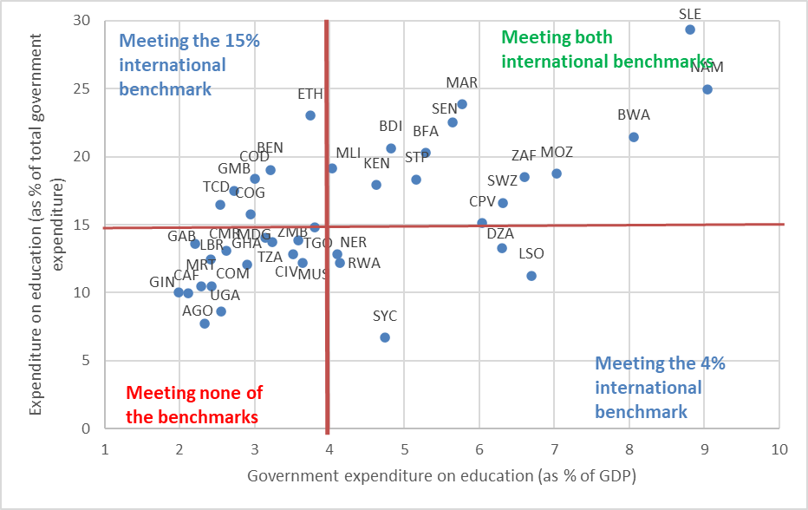
The continent faces an annual average education financing gap of about USD 77 billion until 2030
On average, in 2021, African governments spent 3.7% of GDP on education, around 14.5% of public expenditure
16 out of 42 African countries with data did not meet either UNESCO benchmark
Africa average Tax/GDP ratio 15.6% (LAC 21.7, OECD 34.1)
Source : Authors’ calculations based on UNESCO Institute for Statistics (2023) , UIS Stat (database)
Notes:
Africa’s spending inefficiencies in education remain high: between 2000 and 2017, they were equivalent to over USD 40 billion annually (IMF, 2021_{[41]}). To achieve better learning outcomes with limited funds, cost-effective interventions, such as support for teachers with structured pedagogy and targeted teaching by learning level, could be expanded (Angrist et al., 2023_{[42]}). Applying these types of interventions to reach 90% of primary school pupils in African countries would cost the equivalent of just 2% of the continent's 2021 spending on education while generating a return of 1.2 learning-adjusted years of schooling. Comparable national, regional and international learning assessments can serve to monitor education outcomes and policy impacts. An additional 1.2 years of schooling would translate into around an 11% increase in earnings (authors’ calculation based on estimated returns to education in Africa in Peet, Fink and Fawzi (2015_{[5]})).

Slide 11
High GDP growth has not enabled Africa to catch up with the global productivity frontier
Source: Authors’ calculation based on ILOSTAT productivity statistics (2024)

Slide 12
Job creation has happened in sectors with low productivity, high vulnerability and low skills
Over 80% of African youth in school aspire to work in high‑skilled occupations, but only 8% find such jobs.
Source: Authors’ compilation based on ILOSTAT
Notes:
Africa’s working-age population is growing faster than formal employment opportunities.
The African continent has a higher share of informal employment than any other world region: in 2021, the share of own-account workers and contributing family members of the total working population was 63.9%, compared to 33.9% for Latin America and the Caribbean and 44.9% for developing Asia.
Under current trends, by 2040, own-account and family workers will continue to make up the majority of the labour market, projected to increase from 325 million in 2020 to 529 million people (AUC/OECD, 2021).
About 68% of self-employed workers in Africa, often informal, are underqualified for their occupation compared to 52% in developing Asia and 38% in Latin America and the Caribbean (figure 2).
Considering that pattern, Informal workers may require wider skillsets to succeed :
On a scale of 0 to 5, the level of incorporation of training related to creating or managing SMEs in the education system is rated at 2.5 for primary and secondary education levels in Africa, compared to 3.8 in Developing Asia. This pattern persists in higher education, with lower levels in Africa compared to other developing regions (GEM, 2023)

Slide 13
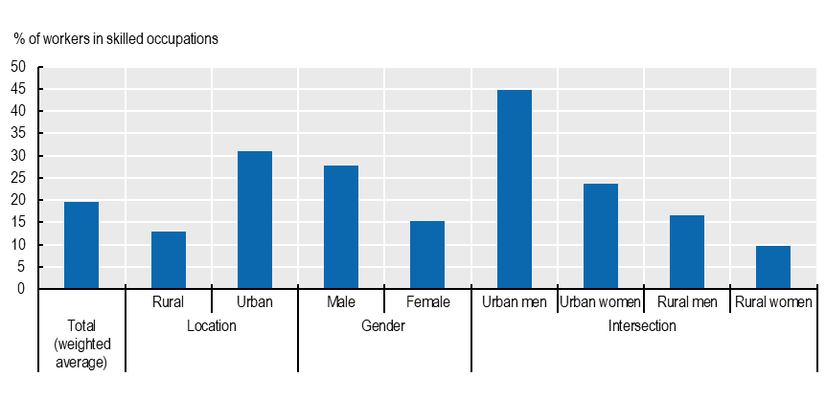
Informal/formal, gender and rural-urban labour market divides compound skill gaps, contributing to inequalities
Informal employment:
  92% in rural areas
  72% in urban areas.
Agriculture and services dominated by informality:
  57% of rural workers are in informal agriculture
  46% of urban workers are in informal services
Share of group in skilled occupations:
  <10% of rural women
  45% of urban men
Gender gaps in education completion rates increase with education levels: the number of countries achieving gender parity is
  8 at primary level
  5 at lower secondary level
  0 at upper secondary level
Source: Authors’ calculations based on UNESCO (2023), World Inequality Database on Education and USAID (2023), DHS Program datasets.
Notes:
Please Note : Data on the left is old (2016) since SWT surveys were discontinued
Despite much progress, skill gaps in African labour markets persist, preventing improvements in labour productivity and the creation of quality jobs.
45% of youth across 10 African countries felt that their skills were inappropriate for their current work (17% felt over-skilled and 28% under-skilled), while 38% indicated that their education was not useful in finding jobs
Data in the second graph is drawn from nationally representative demographic and health surveys (DHS) across 35 African countries collected between 2010-19. Occupational categories provided by DHS have been classified into skilled/unskilled following OECD/UN/ECA/AfDB, (2022) methodology. Skilled occupations are defined as professional, technical, managerial, clerical and skilled manual work. Unskilled occupations are defined as sales, agriculture, household and domestic work, services, and unskilled manual work

Slide 14

Tertiary-educated Africans are more likely to migrate outside the continent
Africa’s stocks of tertiary‑educated migrants per region of origin and destination, in thousand, 2020
East Africa
1 220
17% of all tertiary-educated adults born in Africa were living abroad in 2020, of which 72% chose high-income countries.
600 000 African students in tertiary education pursued their studies outside of Africa in 2021.
East Africa
2 495
North Africa
2 931
Rest of the world
5 873
Central Africa
601
West Africa
1 529
North Africa 52
Southern Africa
913
Central Africa 272
West Africa 275
Southern Africa 213
Source: Authors’ calculations based on World Bank (2023), Global Bilateral Migration (database)
Notes:
In 2020, 17% of all tertiary educated adults that were born in Africa were living abroad.
Of these 17%, 72% chose high-income countries.
This is even greater for East Africa: almost half (47%) of tertiary-educate adults born in the region was living in another country, of which 53% had moved to high‑income countries and 46% to another African country.
Students: 600 000 African students in tertiary education left their studies in Africa in 2021, to continue them in another country. This corresponds to 3.3% of all African tertiary‑level students, against 1.8% in developing Asia and 1% in LAC.
Skills: LinkedIn data suggest that employees with skills in advanced technologies (such as mobile application development or artificial intelligence) and working in globalised professional industries (e.g. higher education, research or computer software) emigrate from African countries, likely due to better pay and career opportunities ​
Consequences of this brain drain :
Migrant workers face skill loss when they can't leverage their expertise upon returning home, hindering reintegration due to a mismatch with local demand
This underutilisation of human capital exacerbates brain drain, leaving untapped talent pools and skill gaps in the national labor market
To tackle this, it's essential to invest in local talent through skill development initiatives and the creation of improved job opportunities
Regional policies are key to retain talents. This include :
Harmonised qualification framework and skill accreditation
African continental Qualifications Framework (ACQF)
Cross-country skill development programmes
Centers of Excellence (CoEs)
Regional training Centers
Intra-African exchange programmes
Skills mobility partnerships (SMPs) ➔ these agreements emphasise temporary assignments, return initiatives, and specialised trainings. When implemented effectively, SMPs can help destination countries meet skill shortages and labour market needs, improve migrants’ skillsets, and contribute to the sending countries’ development through remittances and capacity building.

Slide 15




Policies must tackle new trends, like growing demand for digital skills, green and sector-specific skills
Green skills will help achieve energy security
Sectors | Importance of green skills
 | Adoption of climate-smart agricultural practices in East and Southern Africa could increase agricultural productivity 3-fold
 | Moving towards renewable energy and sustainable infrastructure could generate +9 million job opportunities 2019 - 2030 and a further 3 million jobs by 2050.
 | Central Africa accounts for 70% of the world’s cobalt production, 30% of tantalum and 20% of manganese.
 | Africa’s waste management sector is projected to grow at 8.5% annually.
Skill gaps are widest for intermediate digital skills
 | Basic digital skills | Intermediate digital skills | Advanced digital skills
Demand | Very large 70% of jobs requiring digital skills | Large 23% of jobs requiring digital skills | Emerging Some countries emerging as regional leaders
Supply | Growing 9% of the youth population | Limited 5% of the youth population | Scarce 1.3% of global GitHub users
Agriculture
Renewable Energy
Critical minerals
Waste management
Source: Authors’ compilation based on AUC/OECD (2021); IFC (2021)
Notes:
To accelerate productive transformation, public policies need to tackle the obstacles to digital adoption
The use of more sophisticated DTs and related technologies is associated with higher productivity across African countries for enterprises employing five or more full-time employees (Cirera, Comin, and Cruz 2022).
Digital skills
According to a study from IFC/Oxford Economics, 57 million jobs will require digital skills by 2030 across five countries (Nigeria, Kenya, Côte d’Ivoire, Mozambique and Rwanda).
By 2030,
50-55% of all jobs in Kenya will require digital skills, up from 25-30% in 2019
40-45% of all jobs in Nigeria and Rwanda, up from 20-25% in 2019
35-40% in Côte d’Ivoire will require digital skills, up from 18-23%% in 2019
20-25% in Mozambique will require digital skills, up from 5-10% in 2019
Much of the demand for digital skills will emanate from generic occupations and not from narrowly defined ICT professions, as more enterprises adopt digital technologies in a broad range of sectors
Most demand will target foundational digital skills (70%) which include web research or online/mobile communication (e-mails, teleconferencing).

Slide 16
Effective skills development policies balance high productivity, employment potential, and inclusiveness

Slide 17

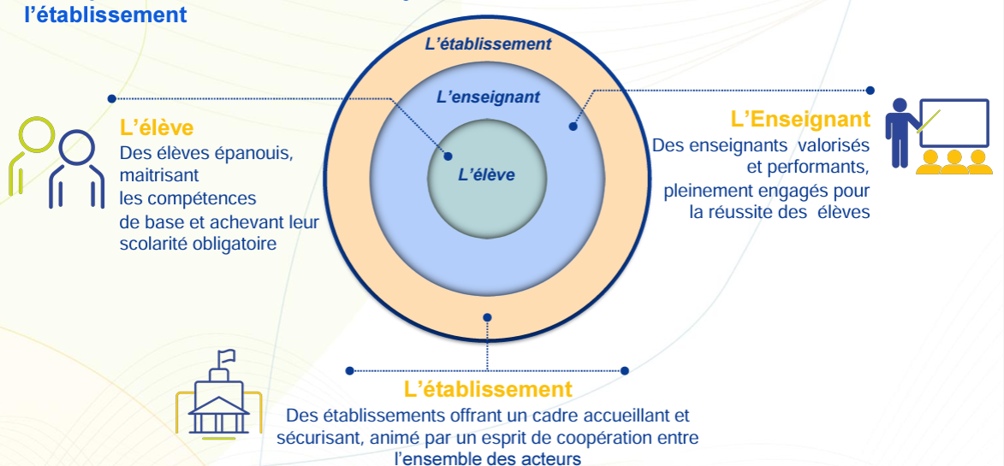



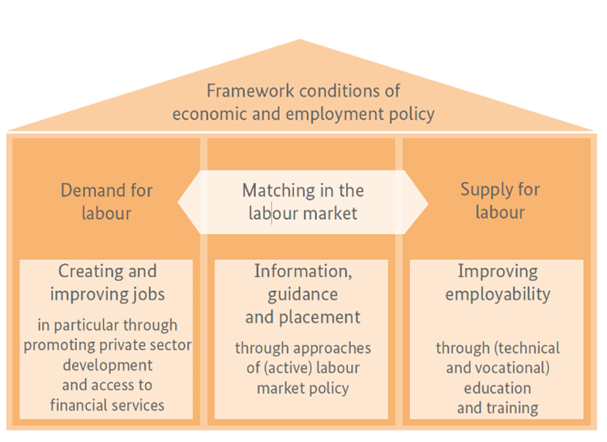

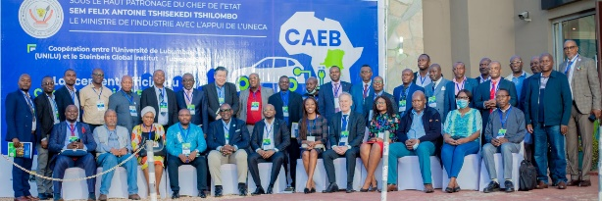
Demand orientation, data and scalable formats are key for effective skills development policies
1. National strategies | Data on skill mismatches Priority sectors with comparative advantages Emphasis on digital and green skills
2. Expand quality education | Most cost-effective measures Progress towards international benchmarks | Morocco’s education reform roadmap
3. Training and skill recognition | Entrepreneurial and soft skills training Certified apprenticeships with private sector Recognition of prior learning; certificates
4. Innovative TVET | Involve private sector in programme delivery Upgrade curricula, governance and reputation Increase female and rural participation TVET levies; coordinate partner finance
5. Regional integration | Skill shortages and gaps in regional value chains Cross-border skill recognition and portability Reduce talent outflow; circulation of skills
Kenya’s National Skills Development Plan
Sector Skills Councils
Informal
enterprises in Togo
Entrepreneurial training
Profit +30%
South Africa’s TVET curriculum reform
Centre of Excellence for
Advanced Battery Research
DR Congo & Zambia
Notes:
1. National strategies
Harmonised, up-to-date and comparable data on skill mismatches
Priority sectors based on national comparative advantages
Emphasis on digital and green skills
Kenya’s National Skills Development Policy 2020 establishes a Sector Skills Advisory Council (with participation of National TVET Authority and Kenyan Chambers of Commerce and Industry) to align with the country’s Vision 2030 strategy
2. Expand quality education
Target investments towards most cost-effective measures
Monitor progress against international benchmarks
In 2022, Morocco’s Ministry of Education rolled out a new roadmap for reforming the education system, designed to respond to the country’s low results in 2018 in OECD’s PISA. The roadmap focuses on learning impact, student well-being and improving foundational learning results
3. Training and skill recognition
Entrepreneurial and soft skills training
Certified apprenticeships in co-operation with the private sector
Recognition of prior learning and professional certificates
Training for informal enterprises in Togo compared the impact of a “personal initiative” intervention (i.e. goal setting, future orientation, problem-solving) based on four monthly mentoring sessions, developed by the Frese Research Group in Germany, to a long-established managerial training programme. The former showed superior gains in productivity, innovation and firm profits (30% vs. 11% gains)
4. Innovative TVET
Involve the private sector (incl. SMEs) in programme delivery
Upgrade curricula, governance and reputation
Increase female and rural participation through local outreach
Accountable TVET levies; improved co-ordination of partner finance
Technical curriculum reviews in South Africa led to the inclusion of renewable energies and emerging technologies in TVET curricula in 2013 and 2023, respectively, with certificates in robotics and renewable energy now available in 29 out of the 50 registered TVET colleges
5. Regional integration
Address skill shortages and gaps along regional value chains
Improve cross-border skill recognition and portability
Reduce talent outflow; encourage international circulation of skills
The Centre of Excellence for Advanced Battery Research between the Democratic Republic of the Congo and Zambia supports private-public co-operation for training and research along different segments of value chains for electric vehicle batteries

Slide 18
Regional chapters

Slide 19
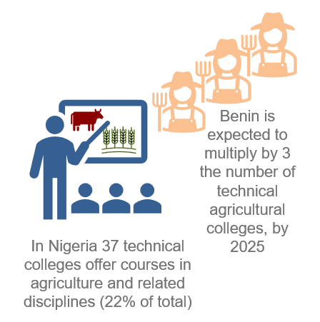
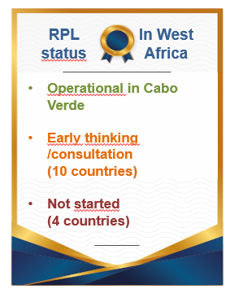
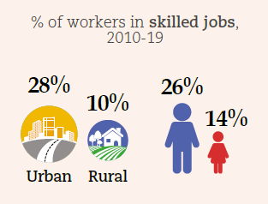
West Africa expands skill acquisition in agri‑food through training and recognition of prior learning (RPL)
Despite advances in STEM education, skilled employment is divided across rural-urban areas and gender
Training is a crucial tool in skill acquisition.
While RPL that validates non-formal, informal and formal learning covers key sectors, it is yet to extend to the agriculture sector
The percentage of STEM teachers in West Africa is approaching the 30% target set by Agenda 2063
19% in 2021
13% in 2019
Notes:
In West Africa, the agri-food sector is the largest and fastest-growing employer: 25% of GDP and 45% of employment, which is predominantly informal.
However, the sector suffers from a lack of technical personnel, highlighting the need for more investment in STEM and TVET education.
Labour productivity is half than the African average. The % of post-harvest loss is the highest in Africa (24% of output)
- At the regional level, around 18% of workers in West Africans are skilled, compared with around 22% for the continent. Côte d’Ivoire and Ghana, which have more‑developed manufacturing sectors, employ the highest share of skilled workers in the region, 29% and 27%, respectively.
- While the skill supply and demand is similar across occupations in the agri-food sector, the skill gap is higher amongst industrial engineers.
- However, in 2020, only 9% of secondary school students were undertaking TVET.
- Target 2.1.1 of Agenda 2063 sets the increase in the number of qualified STEM teachers by at least 30% by 2063: West Africa is on the good track to meet this target, with the percentage of STEM teachers increasing from 13% to 19%, between 2019 and 2021.
- The lack of technical skills and awareness of good conservation practices among farmers, processors and traders results in post‑harvest losses of 24% in the region, the highest figure on the continent.
- Recognition of prior learning validates knowledge that informal workers have acquired without formal training and can help them find more productive jobs. Cabo Verde, Ghana, Nigeria, Tanzania, Togo, among others, have developed such programmes.
- Based on prior RPL legislation and pilot projects for RPL qualification in the hospitality sector, Cabo Verde expanded the qualifications for RPL eligibility
to the administrative services and customer support sector in 2021
Decision‑makers could prioritise three lines of action:
Strengthen professionalisation through public-private partnerships and local initiatives
Reduce the skill gap through increased co-operation between research institutions and the private sector
Mobilise investment to enhance workers' skills and respond to global challenges, particularly climate change

Slide 20
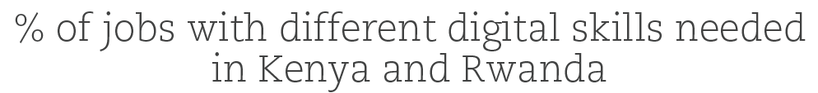
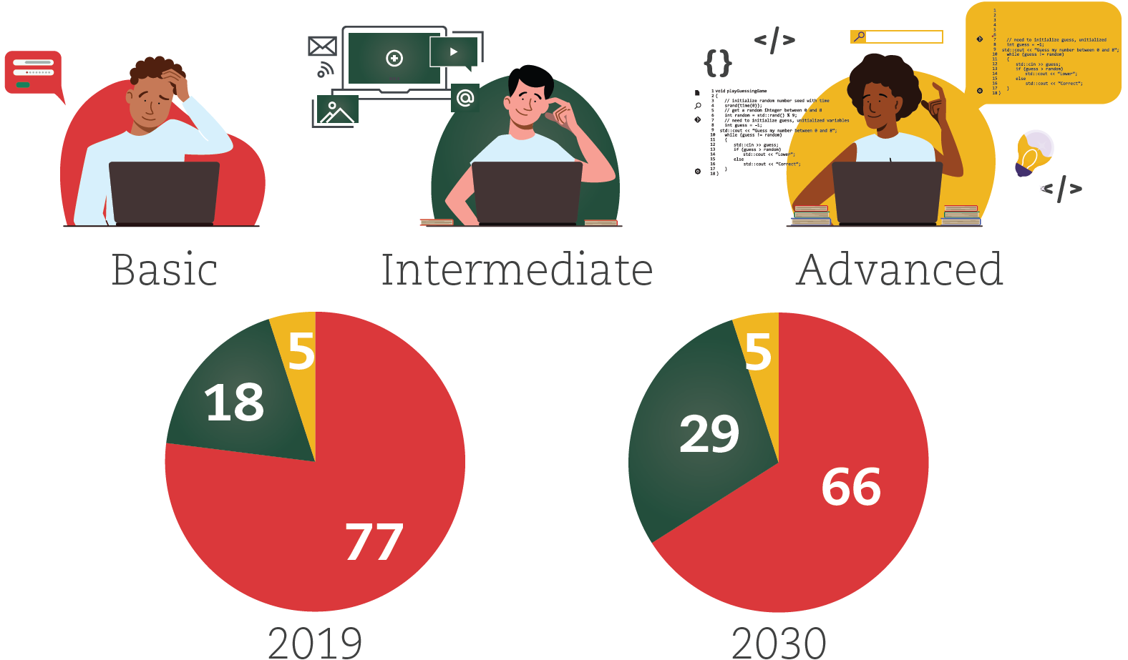
Consultations can inform national strategies of digital skills requirements in East Africa
Quality jobs are scarce in most East African countries
Supply and demand of digital skills is growing unevenly across countries
Export of ICT services
East Africa
Africa
Renewable energies are creating new skill demands in African countries, increasing quality job opportunities
Adoption of climate-smart agricultural practices in East Africa could increase agricultural productivity 3-fold
Notes:
Regarding East Africa, the main takeway, we would like to highlight, with the regional author is that:
a) The region continues to be with the fastest economic growth within Africa (4.9% in 2020-22, compared to 4.4% for Africa as a whole).
b) Although the labour productivity has stagnated for more than 15 years. Less than half of the African average.
c) And this leads to the greatest rate of highly educated emigration in Africa.
d) However, the region’s current expansion of the digital sector, has the greatest potential to drive productive transformation.
e) Rwanda for instance, is a leading example of AI policy implementation
2. In terms of education: The level and quality of education in East Africa are approximately similar to the continent’s average
a) which is 6.7 years. However, adjusted for the quality of education, the duration decreases by over one year, to 5.6 years. This is half a year above the continent. This varies widely across the region, from just 2.5 years in South Sudan to 9.7 years in Seychelles.
3. Digital skills development is also advancing quite well at the regional level, but unevenly across countries
b) This depends on the advancement of a country’s digital economy, and its readiness to adopt information and communications technology (ICT).
Within the region: the Demand is greatest for basic digital skills, compared to intermediate and advanced skills.
c) Additionally, the digital economy in some East African countries can benefit from improved global market integration.
Increased digital service exports indicate a growing demand for workers with intermediate and advanced digital skills, working remotely for firms around the world.
3. East African countries require specific strategies to develop digital skills based on national levels of supply and demand. Measures include:
Expanding Internet access and integrating digital skills into education, which can increase the supply and demand for basic digital skills
Intermediate and advanced digital skill provision can be targeted towards country-specific opportunities and global demand
A single digital market and partnerships can drive the regional integration of digital skills

Slide 21
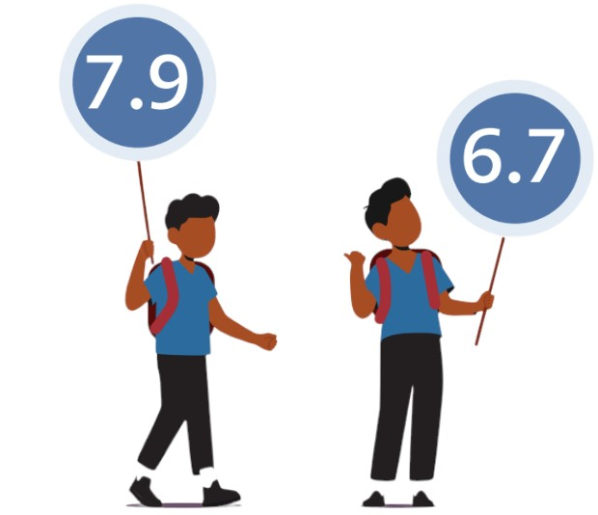






Comparable learning assessments can help monitor education quality to develop renewable energy in North Africa
Education quality in North Africa is above the African average, but inequalities persist
Strengthening skills can support increasing renewable power generation
2nd
3rd
4th
6.1
Average years of schooling vs. Learning-adjusted years of schooling, 2020
5.1
2nd
3rd
Demand for renewable‑energy‑related skills is increasing
North Africa
Africa
Renewable energies are creating new skill demands in African countries, increasing quality job opportunities
+2.7 million in North Africa, comparing the 1.5°C global temperature increase scenario with the business‑as‑usual scenario
+12 million in Africa by 2050, since 2019
&
Notes:
North Africa, despite being the best-educated region in the continent, with strong potential for renewable energy employment, is underutilizing its potential in these areas, highlighting the need for better alignment between education and job market opportunities.
The level and quality of education in North Africa are higher than the rest of the continent, eventhough inequalities persist.
The average years of schooling across the region is 7.9 years.
However, when adjusted to account for the quality of learning, this average falls to 6.1 years – ranging from 7.1 years in Algeria to 4.2 years in Mauritania.
Girls are generally more proficient in reading than in mathematics, but they have higher results than boys in both skills.
3) a) Migration in North Africa is characterised by flows of low‑ and semi‑skilled workers into and out of the region (such as in Libya)
b) and to a lesser extent by the emigration of skilled workers to countries outside the continent - particularly those from Morocco and Tunisia.
4) In 2022, the sector of renewable energies employed at least 21 000 people in the region.
This Employment varies between countries : Morocco accounts for most jobs in the sector (59%), followed by Egypt (18%), Algeria (12%), Tunisia (9%) and Libya (2%).
5) The energy transition could drive economic growth and productive job creation on a continental scale.
Over the past decade, renewable electricity generation is estimated to have risen by over 40%, thanks to the rapid expansion of wind, photovoltaic solar, and solar thermal power.
Egypt, Morocco and Algeria have contributed to the expansion of solar energy in the region, ranking second, third and fourth for solar power generation on the continent.
Egypt and Morocco are also leading in African wind power generation, ranking just behind South Africa.
Assuming a land-utilisation factor of 1% for renewables, North Africa has an electricity generation potential, which is over 12 times Africa’s installed electricity generation capacity and about 3 times Europe’s total installed capacity in 2021
However, the share of renewable energy in the electricity mix (9.5% of electricity generated) remains lower than in the rest of Africa.
7. To develop skills in the renewable energies sector, policymakers could consider three priority measures:
a) Developing national strategies for renewable energies that take into account future skill demand
b) Improving skill supply by promoting on-the-job training, research and development, and centres of excellence
c) Supporting skills development through co-operation with public and private partners at all levels

Slide 22
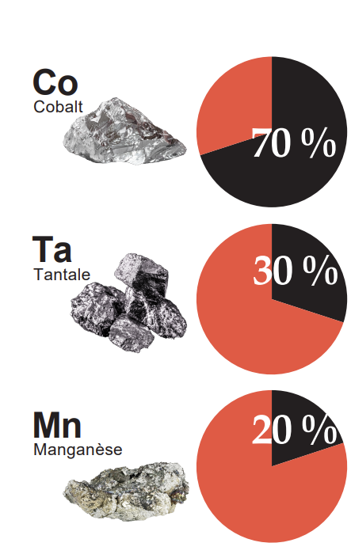
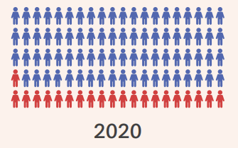

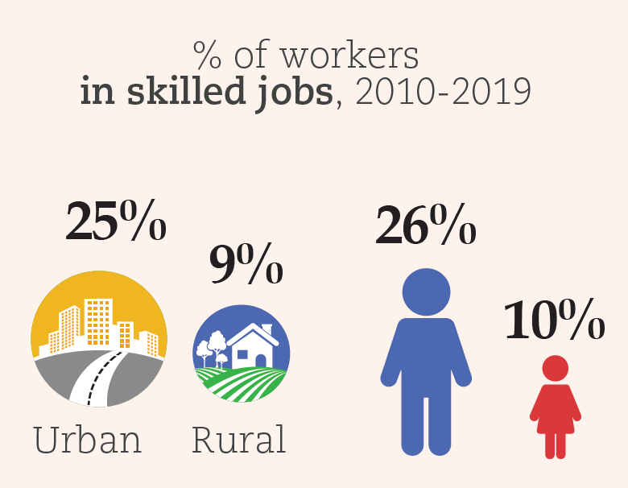
Central Africa can strengthen skills in the mining sector through public-private partnerships and TVET
Access to education and skilled jobs is still limited
Regional production of critical minerals offers opportunities
21% complete secondary education
Global demand x3 by 2040
Global demand x7 by 2040
Global demand x8 by 2040
The Moanda Metallurgical Complex
In Gabon, the Moanda School of Mining and Metallurgy, a public-private partnership, provides training to boost local Manganese processing.
Notes:
Similarly, Gabon, the world’s second‑largest producer of raw manganese, has only been processing the ore since 2015 thanks to the creation of the Moanda Metallurgical Complex
If we look at Central Africa, despite having the best share in comparative advantages, the region suffers from insufficient human capital, resulting in a largely artisanal mining population.
The region can leverage STEM and TVET access, to boost the sector's productivity and economic growth.
1. We can see that access to education and skilled jobs is still limited
As 21% the population completed secondary education.
And disparities prevail between urban and rural, and men and women: In fact, ¼ of workers in urban areas are in skilled jobs, more than in rural areas. And we can see that the same pattern applies to gender disparities.
2. Regional production of critical minerals offers opportunities
Cobalt, tantalum and manganese represent each 70%, 30% and 20% of global demand respectively.
And each of their demand respectively will grow to multiply by 3, 7 and 8 by 2040.
3. In that sense, skills development can be leveraged by the region to promote better positioning within mining value chains, and strengthen productivity of workers, in countries such as DR Congo.
Especially that only less than 20% of young people in tertiary education go into stem
4. To better align skills with jobs, policy makers will need to focus on four priority measures:
1) implementing national and regional strategies based on reliable data to anticipate demand;
2) Stimulating public–private co‑operation to improve TVET;
3) developing training programmes for artisanal and small‑scale mining (ASM) workers;
4) Strengthening governance for better resource allocation.

Slide 23
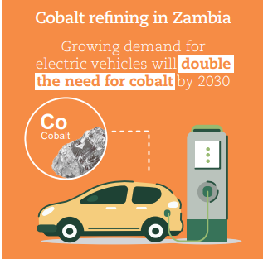
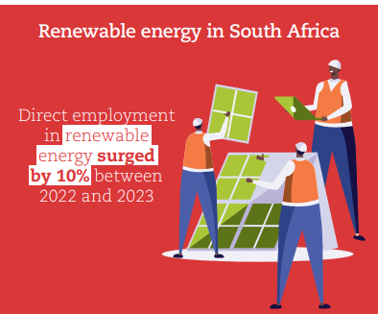
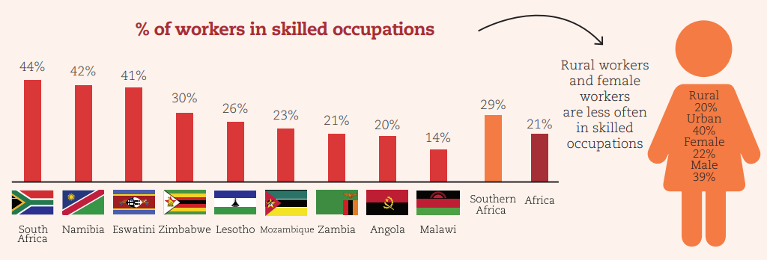
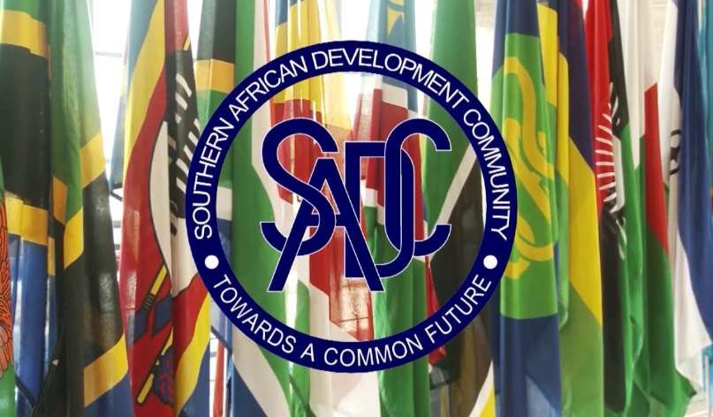
Southern Africa can develop skills in mining value chains through regional cooperation
Skill levels in Southern Africa are on par with the rest of Africa but vary greatly within the region
Skills development for cobalt refining and minerals for renewable energy could strengthen mining value chains
Southern African countries seek to align the sector’s policies through the SADC Protocol on Mining and the Framework for the Harmonization of Mining Policies, Standards and Regulatory Regimes.
They are pivotal to skill formation and skill transfer.
Notes:
The first regional chapter is on Southern Africa, which is one of the richest regions in natural resources.
However, uneven education quality makes it hard to develop the mineral sector, which needs skilled workers.
This limits production, as seen in the diamond extraction and market differences between Botswana and India for instance.
1. The first thing we analyse, along with the regional author, is the education level within the region: Despite education levels similar to the African average, the quality of education varies between Southern African countries
The average year of schooling is 7.5 in the region, versus 6.7 for the Africa continent. However, it shrinks to 5.4 years when controlling for the quality of education (versus 5.1 for the continent).
When we look at school subjects: Math proficiency is very low in the region, with more girls in upper secondary school achieving proficiency in mathematics then boys.
2. The first graph on the left side shows that: The skill gap varies greatly within the region and within the subgroup of population, but impacts even the more developed countries
The % of workers in skilled occupations ranges from 14% in Malawi to 44% in South Africa.
Within countries, rural and female workers are almost twice less likely to occupy a skilled occupation than their urban and male counterparts.
3. Now if we look at the right side of the slide: Skills development for cobalt refining and minerals for renewable energy, could strengthen mining value chains in Southern Africa.
a) In 2023, the EV market for instance accounted for 46% of the demand for cobalt, which was an increase of 22% over 2022.
b) In South Africa, the RE sector in increasing in terms of employment, but also in terms of renewable energy generation, as we will see later at the north Africa’s RE case study.
4. Southern African countries have sought to align their policies at continental and regional levels, namely through the
Africa Mining Vision and the SADC Protocol on Mining, which could more directly emphasise skill development in the sector.
To operationalise the protocol, SADC and ECA’s Southern Africa Office developed a framework laid out in the publication Harmonization of Mining Policies, Standards, Legislative and Regulatory Frameworks in Southern Africa. The initiative harmonises mineral industrial policies, standards and legal frameworks in the region. In addition to its direct fiscal benefits, the framework seeks to enhance skills training in the mining sector. However, its implementation has been criticised as piecemeal, with only slow progress in mineral resource governance across Southern Africa.
In this regard, Southern African policy makers can prioritise three policy actions:
1. Ensure that sound national mining policies and legislative frameworks are well harmonized with regional standards and global best practices.
2. Adapt formal mining education to country‑specific technical, business and digital skill needs.
3. Target education and training programmes more directly towards women and other marginalised groups.

Slide 24


Thank you!
MErCI !
¡GRACIAS!

Slide 25
BACKUP SLIDES

Slide 26
Job board data have the potential to inform granular skill gap assessments
Sampling online job vacancies: gathering data samples from online job postings from African job boards
Analysing skill demand: conducting a dynamic analysis to assess skills sought by employers
Data source | Details | Analysis
Lightcast | Data extracted from job ads (LinkedIn, indeed, etc.) Skills/levels of education required, salaries offered | Identify skill requirements in demand in the African market Salary information allows to construct demand data
Regional Data source | Details | Analysis
Jobberman (Nigeria, Ghana) Brightermonday (Kenya, Uganda) Careerjunction (South Africa) Wuzzuf (Egypt) Emploi.ma (Morocco) Emploi.cm, Emploi.dc (Cameroon, DR Congo) | Skills, salaries and levels of education for a given job Include all industries (IT, energy, healthcare, construction, automotive…) | Identify trends in labour markets (e.g. emerging occupations)

